Slide 1






Data Visualization NASA Astronauts 1959-2013
Edgardo Panza
Lucas Whitmire
Federico Rueda Luna
Master of Data Science – SuSe 2020

Slide 2
Facts
Women were not eligible to be astronauts: all astronauts were required to be military test pilots, a career not available to women at the time.
The Astronaut Class of 1978, otherwise known as the "Thirty-Five New Guys," was NASA's first new group of astronauts since 1969. This class was notable for many reasons, including having the first African-American, the first Asian-American astronauts and especially recognizes as being the first to recruit women.
Sally Kristen Ride became the first American woman in space in 1983.
2
Notes:
https://www.nasa.gov/topics/history/features/flats.html
https://history.nasa.gov/40thann/define.htm
2

Slide 3
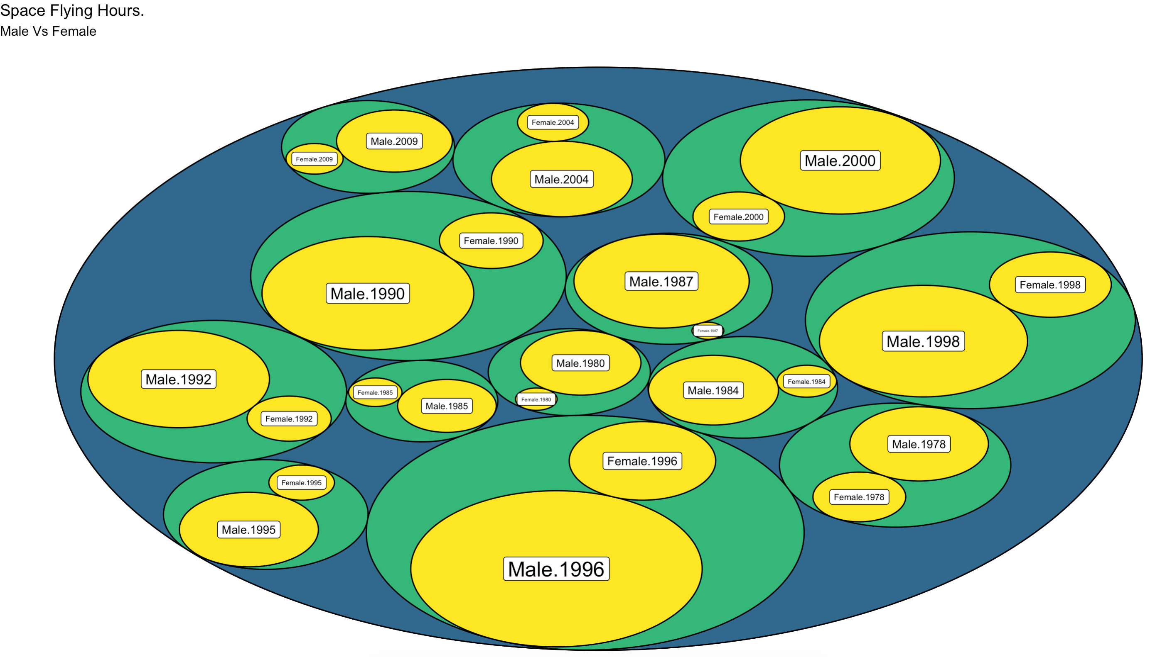
Women in space
3
Notes:
Here we can see some space flights even there are no records of missions, but there was a lot of training so we assume they count that time. https://www.nasa.gov/centers/johnson/news/releases/1978_1980/index.html
3

Slide 4
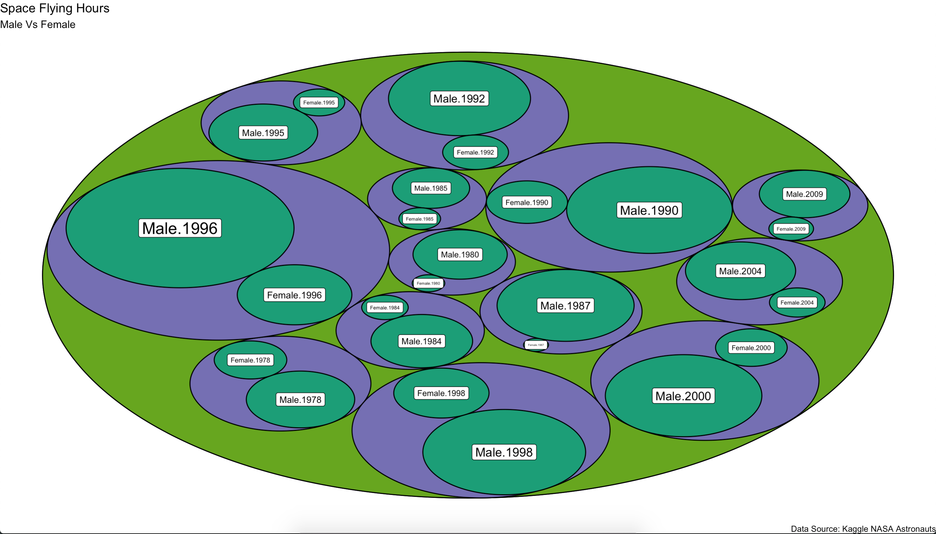
Women in space
4
Notes:
Here we can see some space flights even there are no records of missions, but there was a lot of training so we assume they count that time. https://www.nasa.gov/centers/johnson/news/releases/1978_1980/index.html
4

Slide 5
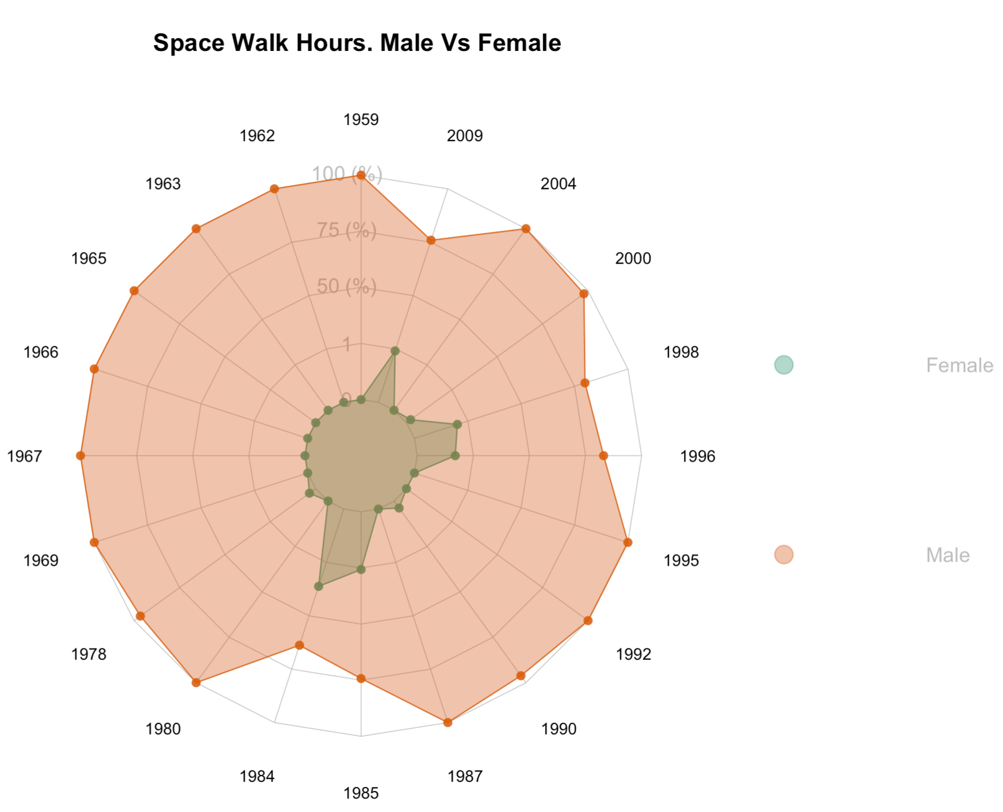
Women in space
5
Notes:
Even after the inclusion of women in space programs we can see that even they started to flying on missions on 1983 there isn’t an inclusion in the space walks.
5

Slide 6
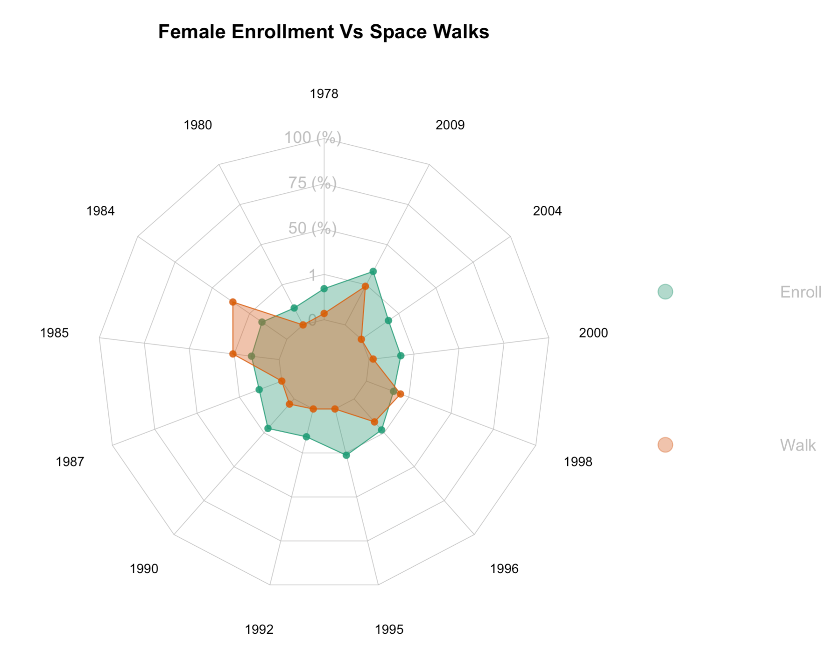
Women in space
6
Notes:
Even after the inclusion of women in space programs we can see that even they started to flying on missions on 1983 there isn’t an inclusion in the space walks.
6

Slide 7
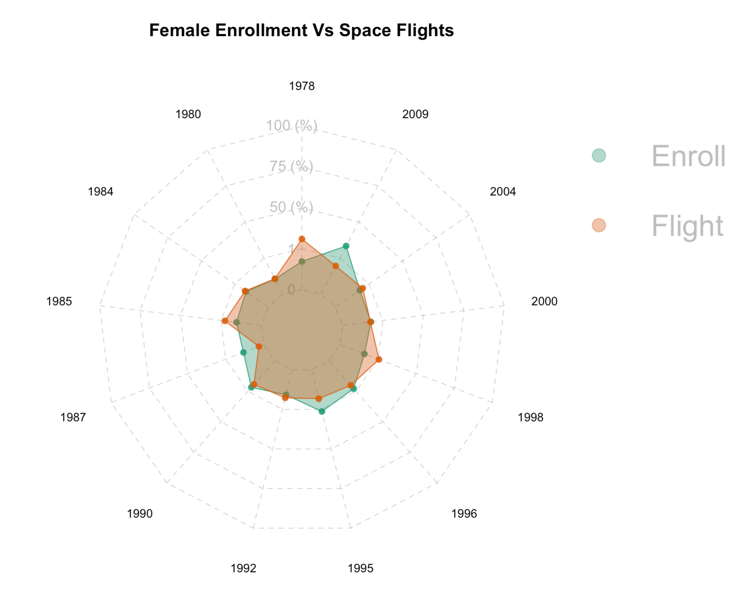
Women in space
7
Notes:
Even after the inclusion of women in space programs we can see that even they started to flying on missions on 1983 there isn’t an inclusion in the space walks.
7

Slide 8
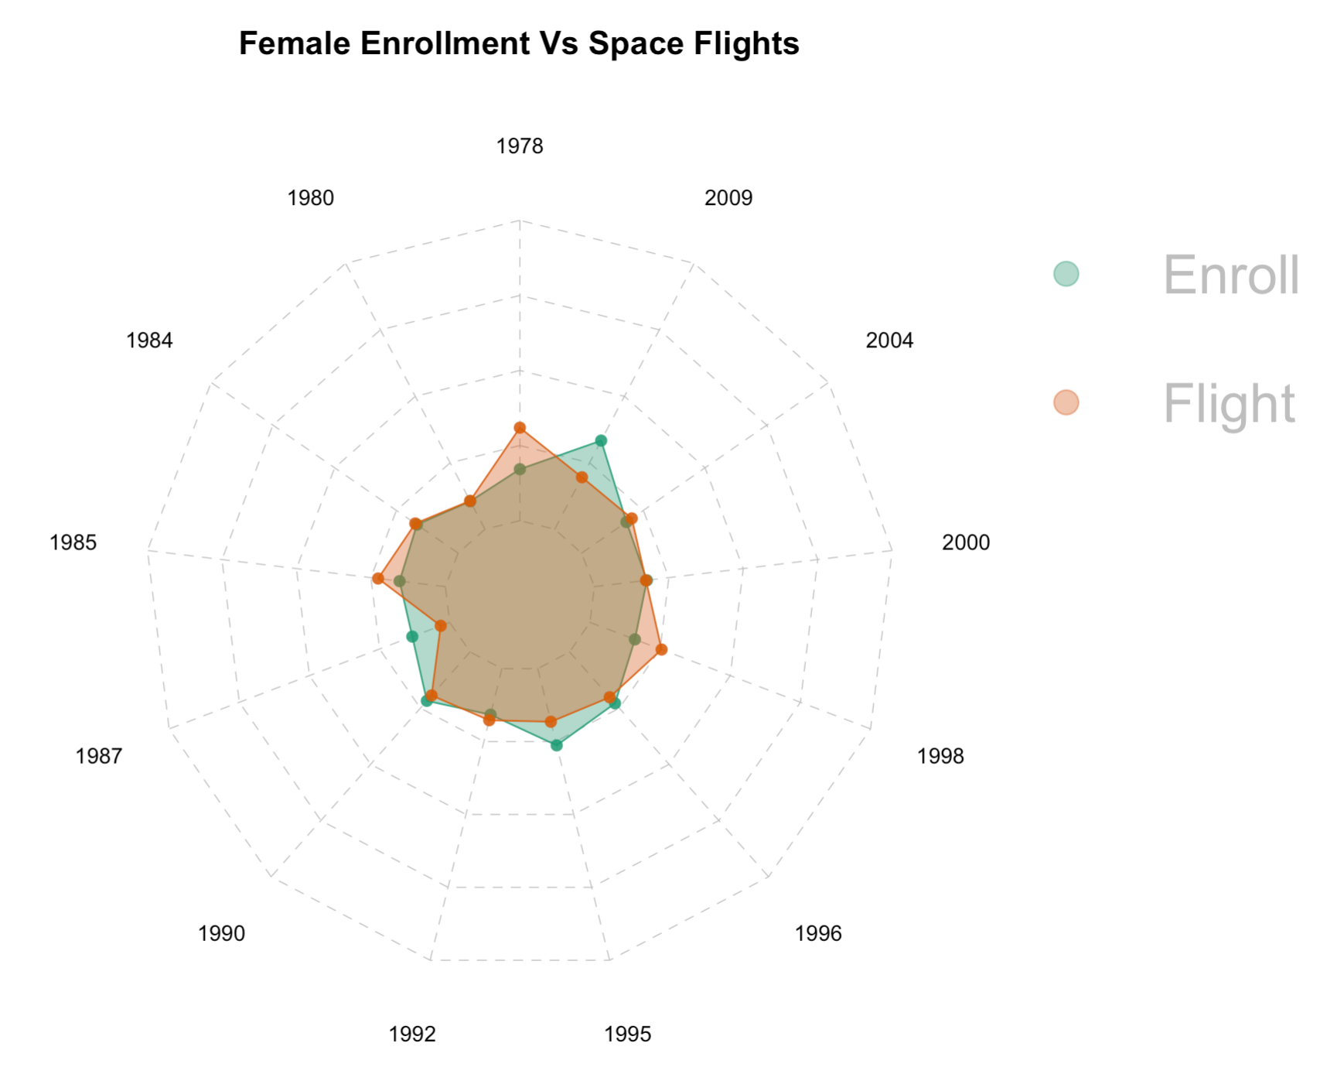
Women in space
8
Notes:
Even after the inclusion of women in space programs we can see that even they started to flying on missions on 1983 there isn’t an inclusion in the space walks.
8

Slide 9
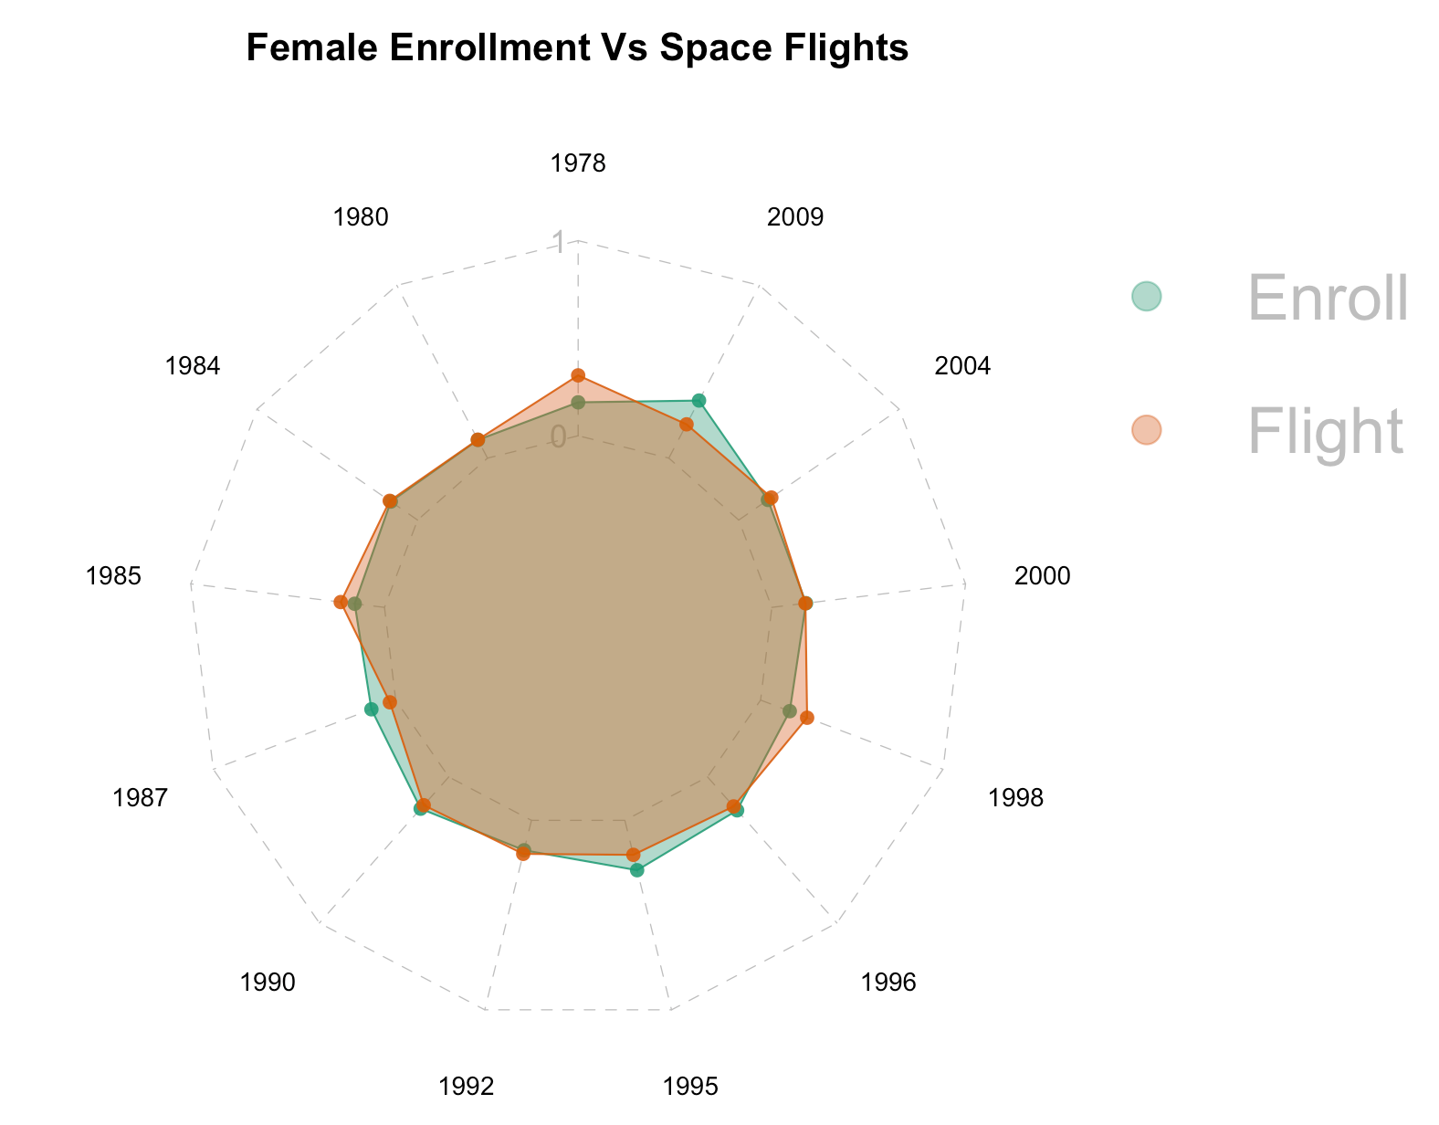
Women in space
9
Notes:
Even after the inclusion of women in space programs we can see that even they started to flying on missions on 1983 there isn’t an inclusion in the space walks.
9

Slide 10
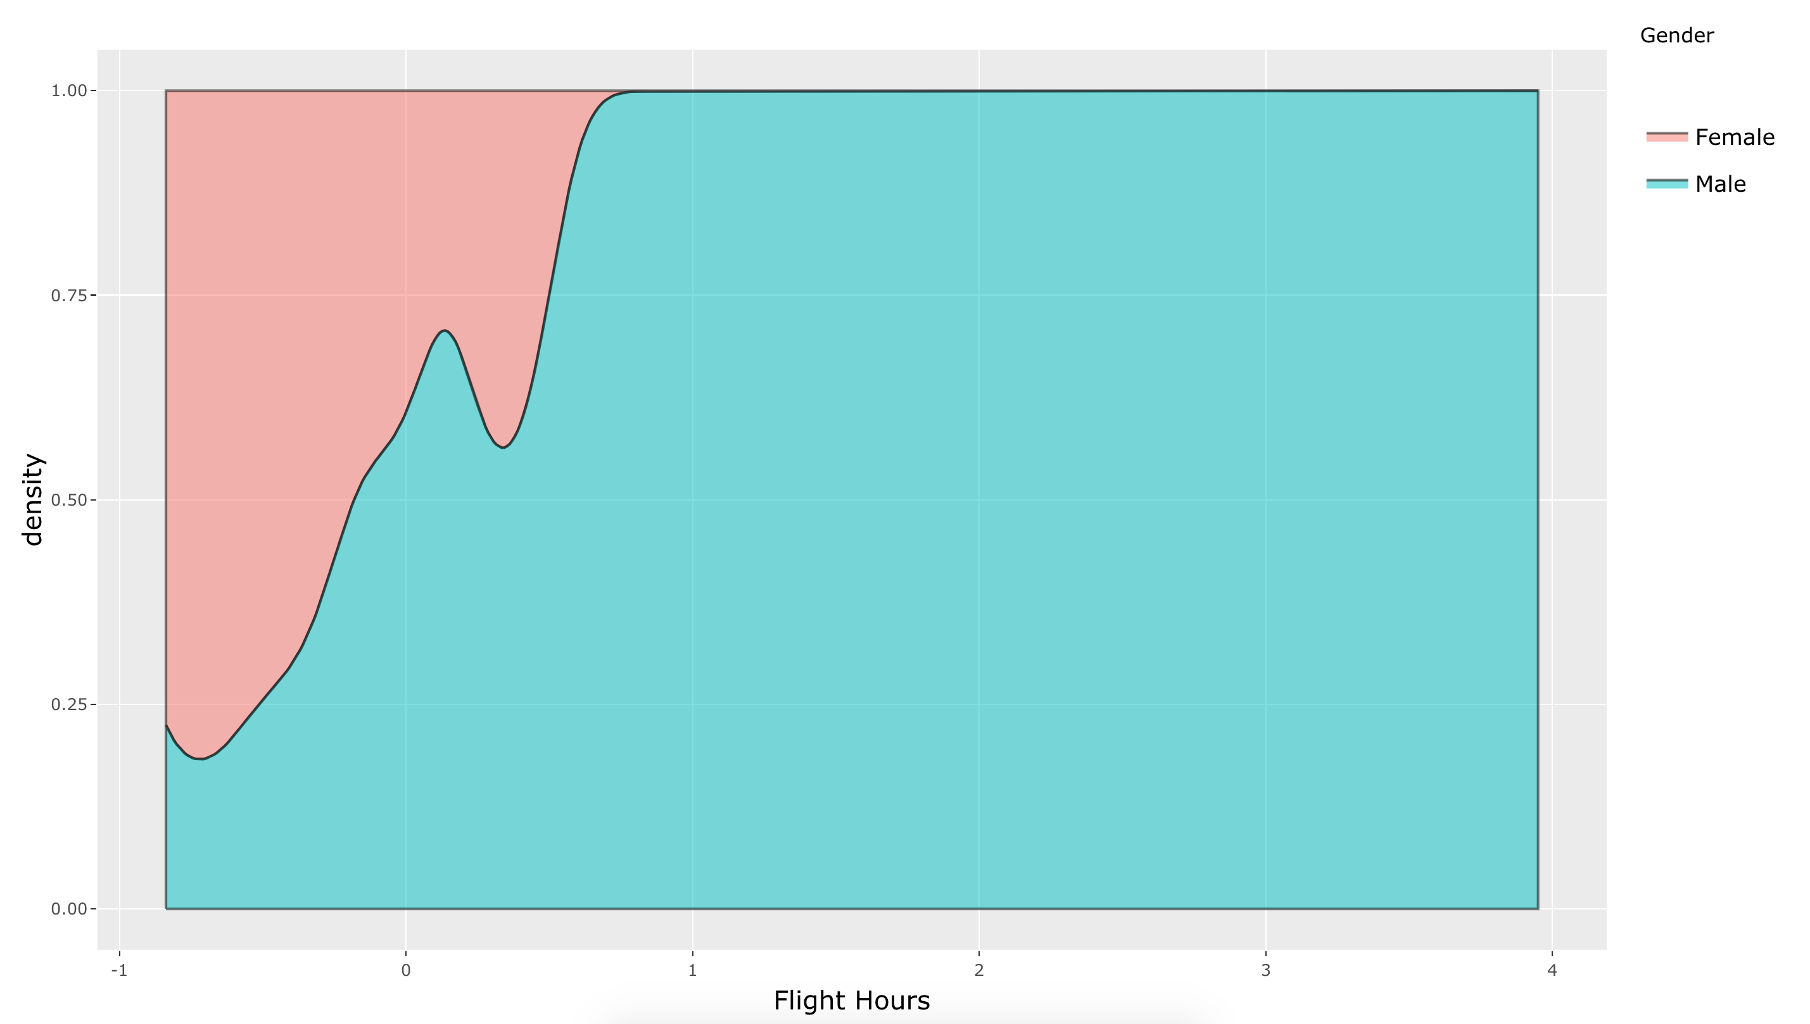
Women in space
10
Notes:
Even after the inclusion of women in space programs we can see that even they started to flying on missions on 1983 there isn’t an inclusion in the space walks.
10

